Slide 1
Image Caption Generator using Visual Attention
Abhishek Sau

Slide 2
Goal
The goal of image captioning is to convert a given input image into a natural language description
This project is an amalgamation of computer vision and NLP
This project is based on the paper – Show, Attend and Tell
Notes:
The problem of producing a description based on the input image is known as image captioning.
Automatically creating captions for an image is a challenge at the core of seen perception which is one of computer visions main objectives.
Not only, most caption generation models are capable of overcoming the computer vision challenges of designing with objects present in an image but they must also be capable of capturing and expressing their relationships in natural language.

Slide 3
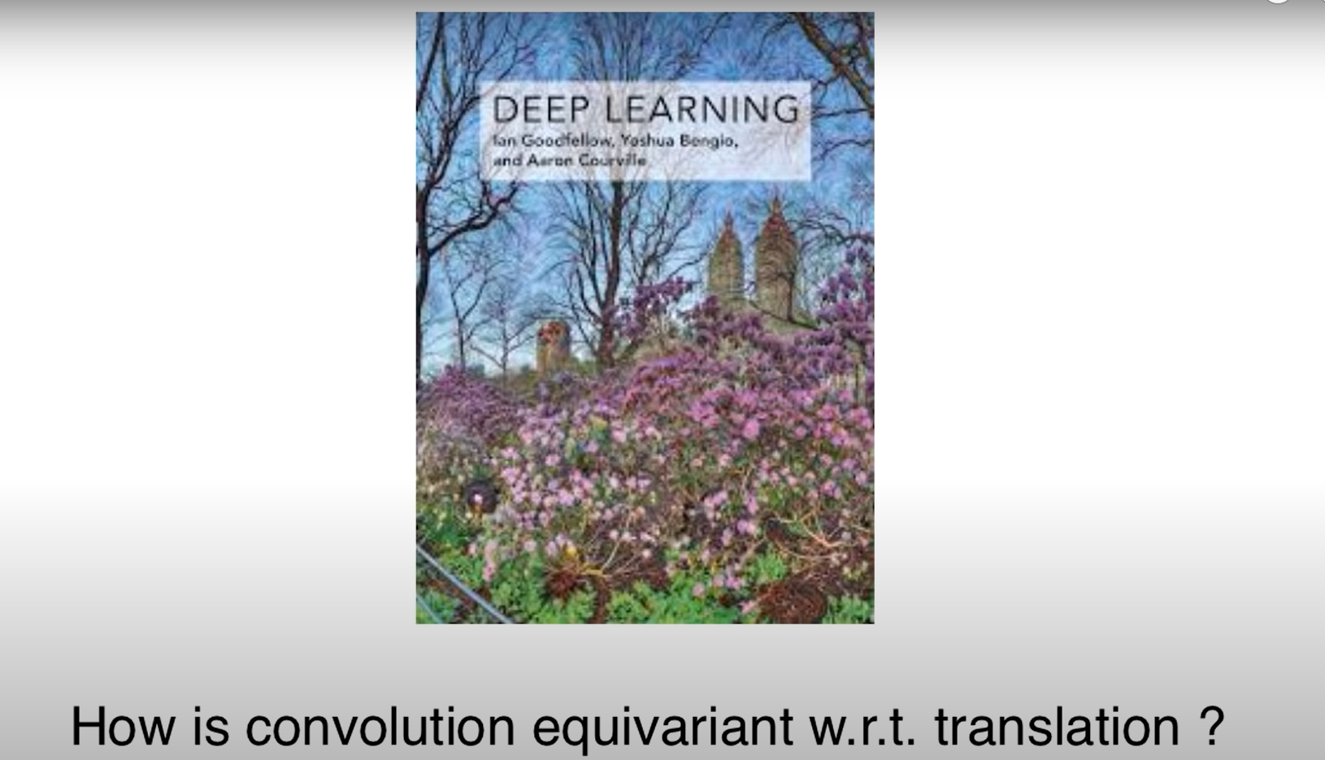
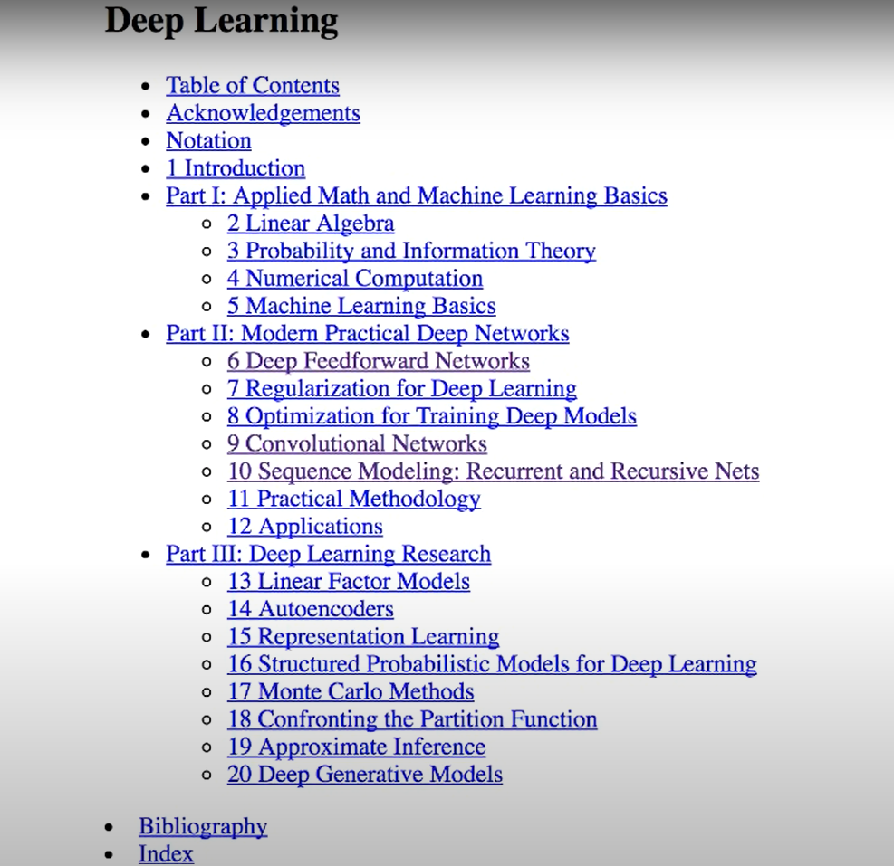
Visual Attention
Notes:
I give you this book on Deep learning and as you the following question.
There are two ways this can be answered.
Reading the whole book and then answering the question, which let’s suppose can take upto a week to answer.

Slide 4
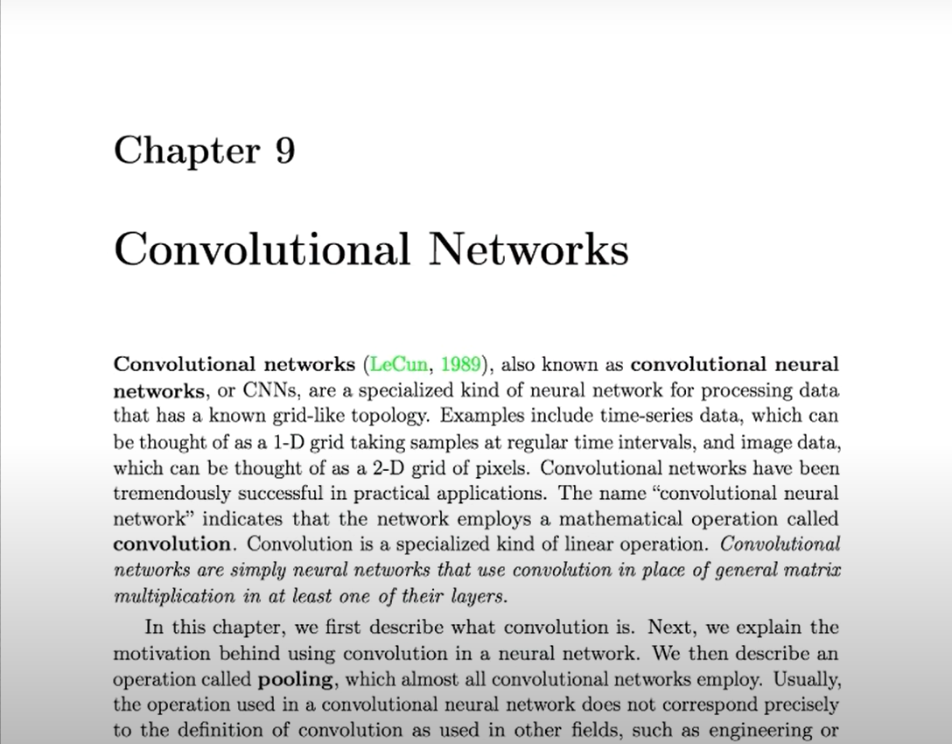
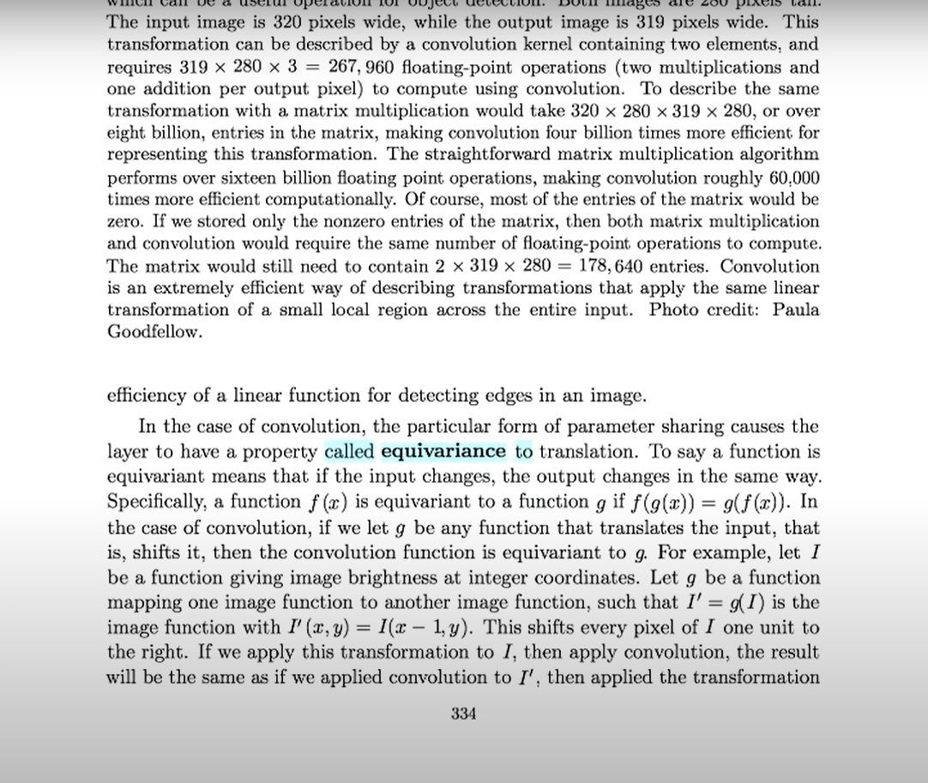
Visual Attention
Notes:
There’s a better way. Since it’s a question on convolution I flipped the chapter on convolution neural networks then I find equivariance as one of the properties and read out that page or at least that part of page.
This is an approach that would be the exact thought process many of us humans would take it’s quite intuitive
Attention mechanisms found in neural networks is somewhat similar to that found in humans they focus in high resolution on certain parts of the input while the rest of the input is in low resolution or blurred

Slide 5
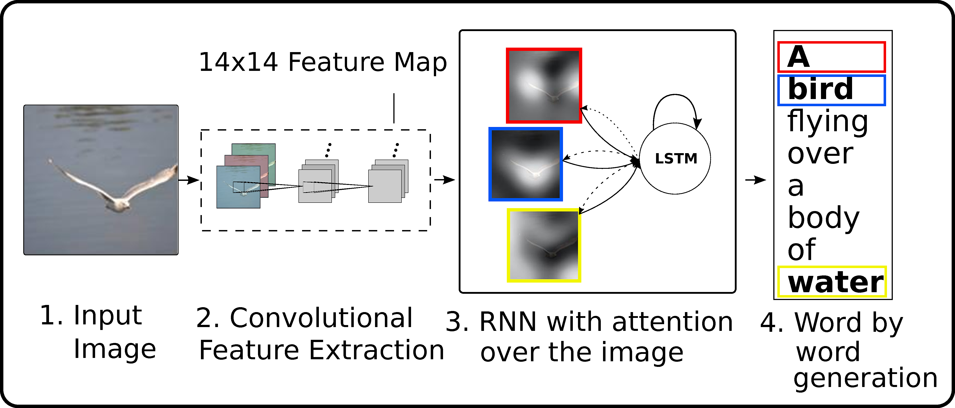
Model Architecture
Notes:
The model takes a raw image as its input,
the picture is then processed using a convolutional neural network through three features. In an encoder decoder model this CNN acts as an encoder

Slide 6
Model Architecture
Raw Image as Input
CNN Encoder and Feature extractor
RNN Decoder with Attention mechanism
Word by word generation

Slide 7
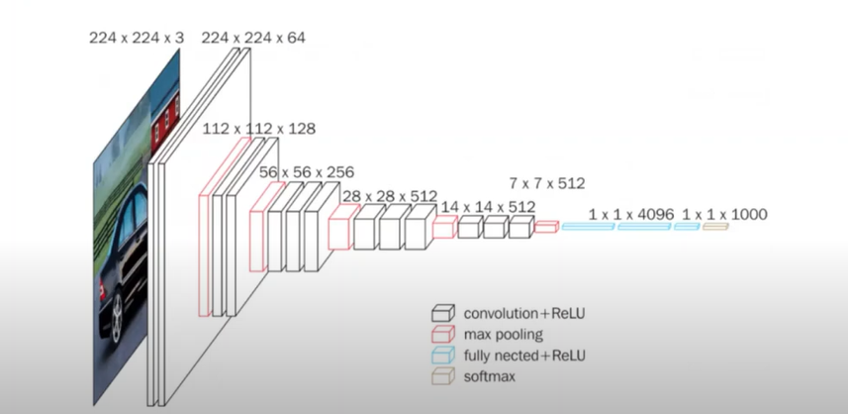
CNN Feature Extractor
VGG architecture processes an image through sequential convolutional layers followed by Max pooling and finally outputs a vector that captures the meaning of the image
Notes:
CNN used in this paper is using the VGG architecture which is shown in this slide. VGG architecture processes an image through sequential convolutional layers followed by Max pooling and finally outputs a vector that captures the meaning of the image. In order to obtain a correspondence between the feature vectors and the portions of the 2D image, we extract features from a lower convolutional layer instead of using a fully connected layer. We take a 14 by 14 by 512 feature map. And by flattering each one of the fourteen by 14 matrices in the feature map we turn them into a set of vectors which we refer to as annotation vectors. The extractor produces L vectors each of which is a D-dimensional representation corresponding to part of the image. By concatenating these annotation vectors we generate matrix A, which is the output of the CNN encoder, which is then used by the attention model to determine which sections of the image are more relevant in generating the next word in the image caption generation task.

Slide 8
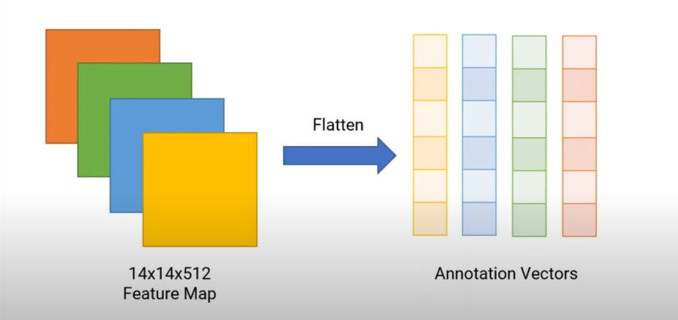
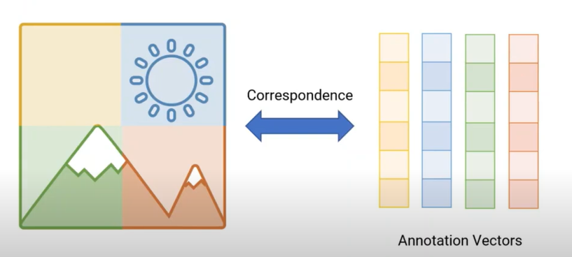
CNN Feature Extractor
Extracts Features map of shape 14X14X512
Flattens the feature map in a 196X512 vector
Notes:
CNN used in this paper is using the VGG architecture which is shown in this slide. VGG architecture processes an image through sequential convolutional layers followed by Max pooling and finally outputs a vector that captures the meaning of the image. In order to obtain a correspondence between the feature vectors and the portions of the 2D image, we extract features from a lower convolutional layer instead of using a fully connected layer. We take a 14 by 14 by 512 feature map. And by flattering each one of the fourteen by 14 matrices in the feature map we turn them into a set of vectors which we refer to as annotation vectors. The extractor produces L vectors each of which is a D-dimensional representation corresponding to part of the image. By concatenating these annotation vectors we generate matrix A, which is the output of the CNN encoder, which is then used by the attention model to determine which sections of the image are more relevant in generating the next word in the image caption generation task.

Slide 9
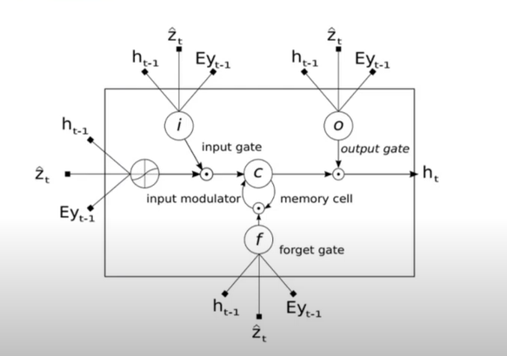
RNN with Attention over images
Uses LSTM architecture
Z is the context vector
E is Embedding matrix
Y is previously generated word at time t
H is hidden state at time t
Notes:
An RNN works like this; First words get transformed into machine-readable vectors. Then the RNN processes the sequence of vectors one by one.
Recurrent Neural Networks suffer from short-term memory. If a sequence is long enough, they’ll have a hard time carrying information from earlier time steps to later ones.
During back propagation, recurrent neural networks suffer from the vanishing gradient problem. Gradients are values used to update a neural networks weights. The vanishing gradient problem is when the gradient shrinks as it back propagates through time. If a gradient value becomes extremely small, it doesn’t contribute too much learning.
An LSTM has a similar control flow as a recurrent neural network. It processes data passing on information as it propagates forward. The core concept of LSTM’s are the cell state, and it’s various gates. The cell state act as a transport highway that transfers relative information all the way down the sequence chain. You can think of it as the “memory” of the network. The cell state, in theory, can carry relevant information throughout the processing of the sequence. So even information from the earlier time steps can make it’s way to later time steps, reducing the effects of short-term memory

Slide 10
Dataset
Flickr8k (Kaggle)
8091 images
~35000 captions (5 captions per image)
Notes:
A new benchmark collection for sentence-based image description and search, consisting of 8,000 images that are each paired with five different captions which provide clear descriptions of the salient entities and events. … The images were chosen from six different Flickr groups, and tend not to contain any well-known people or locations, but were manually selected to depict a variety of scenes and situations

Slide 11
Thank You!

